Slide 1


THE 16th INTERNATIONAL IEEE CONFERENCE ON COMPUTING, COMMUNICATION AND NETWORKING TECHNOLOGIES (ICCCNT - 2025)
July 6 - 11, 2025, IIT - Indore, Madhya Pradesh, India.
Adaptive Multimodal AI Assistant with Emotion
and Sentiment Awareness
PAPER ID - 6077
Authors: Tanzeel Ahmad¹, Kuldeep Chaurasia², Gaurav Kumar Jaiswal³, Mukund Pratap Singh⁴ , Jatin Bisht⁵
Presented By
Mr. Tanzeel Ahmad
Bennett university greater Noida, Uttar Pradesh, India

Slide 2

Agenda
Introduction
Motivation & problem
reLated Work
System Architecture
Methodology
Datasets & Data Splits
Multimodal Input Processing and Fusion Strategy
Experiments & Results
Conclusion & Future Work
References

Slide 3

Introduction
Traditional conversational AI systems often rely solely on text or audio, limiting their emotional awareness.
We introduce NeuroSentient, a multimodal, resilient AI assistant capable of inferring user emotion from both speech and text streams.
The system is engineered to maintain consistent emotional understanding under adverse conditions, including background noise, modality failure, and offline settings.
It is there to implement dynamic fallback strategies to ensure system robustness and conversational continuity.
Design a scalable, offline-capable, and emotionally adaptive AI assistant for real-world deployment.

Slide 4
Motivation & Problem
Most existing AI systems rely on single-modality input, primarily text or audio, which makes them fragile in dynamic environments.
Unimodal systems lack redundancy — a failure in Automatic Speech Recognition (ASR), background noise, or missing text input leads to inaccurate or non-empathetic responses.
There is a pressing need for a robust, multimodal emotion recognition system that remains adaptive, accurate, and empathetic
Our Goal is to design an AI assistant capable of understanding emotion across both speech and text, with a fallback-capable architecture that ensures resilient, emotionally intelligent interactions, even under real-world constraints.

Slide 5

ReLated Works
Recent transformer-based models like Whisper (OpenAI) and Wav2Vec2.0 (Meta AI) have redefined SER by offering robust emotion encoding even in noisy, real-world conditions.
NLP models like RoBERTa, XLM-RoBERTa, and DistilRoBERTa have proven effective for fine-grained emotion and sentiment classification, especially across multilingual and social media datasets.
Works like Tensor Fusion Networks, Multimodal Transformer Fusion (MTF), and MemoCMT show that combining text and audio enhances emotion prediction accuracy.
LLMs (e.g., GPT-4, OpenHermes, Mistral-7B) are highly capable conversational agents, but they are not inherently empathetic.
Most real-time assistants rely on cloud-based pipelines, making them vulnerable to modality dropout or network failure.

Slide 6
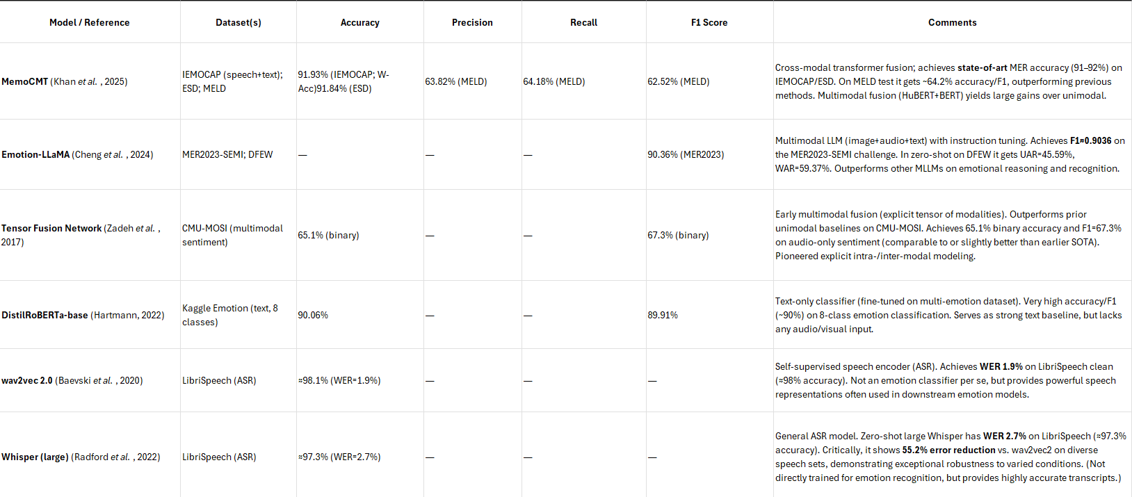
RELATED WORKS – LITERATURE REVIEW

Slide 7

System architecture
The system comprises two parallel pipelines—one for speech (Whisper ASR + Wav2Vec2) and one for text (RoBERTa/XLM-R)—that operate independently yet are fused at the emotion interpretation stage.
A fusion mechanism, using either confidence-based weighting or a transformer-based encoder, integrates emotion vectors from both modalities to generate a unified emotional state guiding the assistant’s response.
The architecture includes dynamic fallback routing at every stage (ASR, LLM, TTS), enabling robust operation under noise, poor connectivity, or missing inputs—ensuring graceful performance degradation and offline functionality.

Slide 8
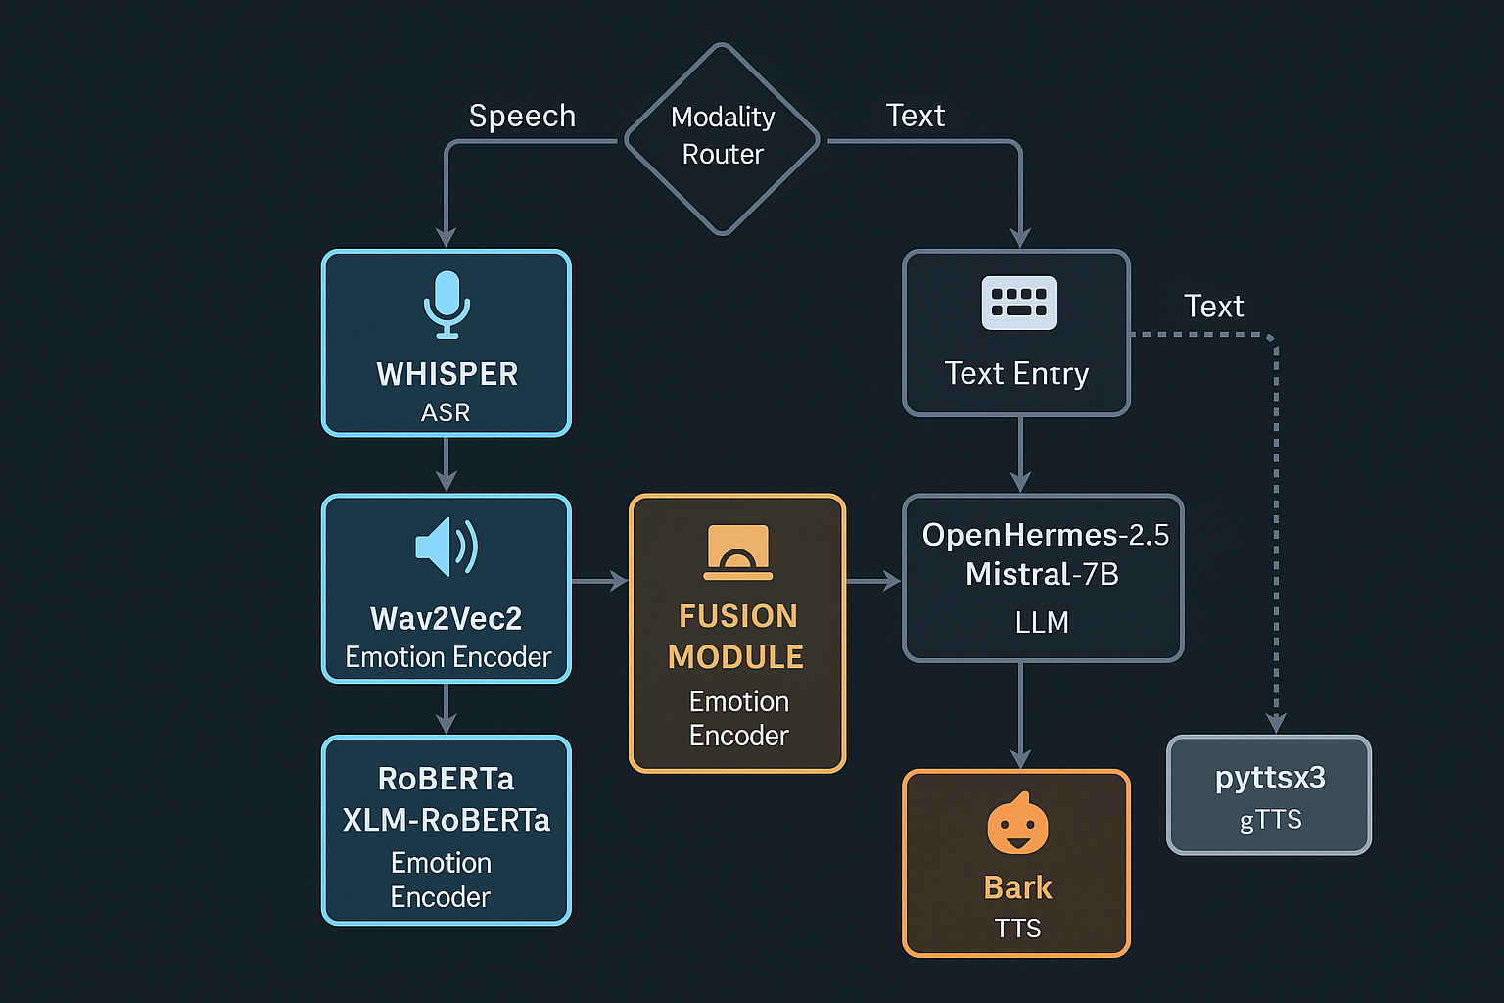
Methododlogy
Audio is processed via Whisper (ASR) and Wav2Vec2 (emotion encoding), while text is handled by RoBERTa/XLM-RoBERTa for sentiment and emotion recognition.
Emotion signals from both streams are fused to guide tone and context. This fused representation is passed to an LLM (OpenHermes-2.5/Mistral-7B) to generate contextually aware responses.
A dynamic router selects appropriate paths based on modality confidence. Fallbacks activate for ASR (manual input), LLM (Falcon/RAG), or TTS (pyttsx3/gTTS) to ensure resilience and uninterrupted interaction.

Slide 9
Datasets & Data Splits
Datasets Used
RAVDESS: 1,440 clips – acted speech, 8 emotion classes
MELD: 13.7k utterances – TV dialogues, 7 emotions
GoEmotions: 58k Reddit texts – 28 emotion labels
CREMA-D, IEMOCAP, TweetEval: for added emotion diversity & robustness
Cross-Corpus Evaluation
Models trained on RAVDESS + CREMA-D, evaluated on MELD and GoEmotions
Measures generalization across domains
Train–Validation–Test Splits
Standard ratio: 80% Train / 10% Validation / 10% Test
Stratified sampling preserves class balance
No speaker/conversation overlap to avoid leakage
Fairness
Data balanced by gender, speaker diversity
Rare emotions augmented using SpecAugment, noise injection, text paraphrasing

Slide 10
Multimodal Input Processing and Fusion Strategy
Audio is transcribed via Whisper and analyzed by Wav2Vec2, while text is processed using RoBERTa/XLM-R for emotion and sentiment cues.
A Sentiment Fusion Layer combines both modalities to drive emotionally aligned responses, adapting tone and personality.
Fallback mechanisms (for ASR, LLM, and TTS) are managed by an MDP-based Modality Router to ensure continuity even with partial input or failures.
Normalizing
Audio and text inputs are pre-processed into stable representations
Embedding
Convert audio to emotion vectors and text to semantic embeddings
Align
Synchronize modalities within a consistent temporal framework
Classify
Predict emotional state with a shared representation
Fusion
Merge emotion vectors with semantic features

Slide 11
Experiments & Results-I
Data Preprocessing:
Audio: VAD using Silero, 16kHz resampling, Wav2Vec2 embeddings
Text: SpaCy normalization, tokenization, NER, subword encoding
Speaker Diarization: PyAnnote for conversation segmentation
Data Splits: 70% Train / 15% Validation / 15% Test (Stratified & speaker-disjoint)
Training Approach:
Text Models: XLM-R (sentiment), DistilRoBERTa (emotion)
Speech Models: Wav2Vec2 fine-tuned on SUPERB benchmark
Fusion: Valence-weighted strategy with dynamic confidence weighting
Fallbacks: Falcon-7B (LLM), gTTS/pyttsx3 (TTS), Manual text in low-ASR cases
Dataset | Modality | # Samples | # Classes | Emotions Covered | Language(s)
RAVDESS | Speech (audio) | 1,440 | 8 | neutral, calm, happy, sad, angry, fearful, surprise, disgust | English (North American)
CREMA-D | Speech (audio) | 7,442 | 6 | neutral, happy, sad, angry, fearful, disgust | English (US)
IEMOCAP | Multimodal (speech + text) | ~10,000 utterances | 6 (commonly used) | angry, happy (excited), sad, neutral, frustrated, surprised | English (US)
MELD | Multimodal (audio + text) | 13,708 | 7 | anger, disgust, sadness, joy, surprise, fear, neutral | English (TV dialogues)
GoEmotions | Text (social media) | 58,000 | 27 + neutral | fine-grained emotions (e.g., admiration, grief, joy, etc.) + neutral | English (web text)
DailyDialog | Text (dialogues) | 13,118 | 7 | anger, disgust, fear, happiness, sadness, surprise, neutral | English (dialogues)

Slide 12
Experiments & Results-II
Metric | No Prompt | With EmotionPrompt
Emotion Coherence Score | 63.2% | 87.6%
Empathy (Human rating) | 3.1 / 5 | 4.4 / 5
Appropriateness | 3.4 / 5 | 4.6 / 5
Fluency | 3.7 / 5 | 4.5 / 5
Model Name | Accuracy | F1 Score | Recall | Precision | Comment
Text-Only (RoBERTa/XLM-R) | 84.2% | 83.7% | 83.1% | 84.3% | Strong on text sentiment, but lacks tonal/emotional nuance.
Speech-Only (Wav2Vec2) | 81.3% | 80.5% | 80.0% | 80.8% | Accurate on clean speech, degrades in noise.
Model 1: BiLSTM + GRU + SNN | 89.5% | 88.3% | 87.9% | 88.7% | First proposed hybrid deep model — strong at temporal emotion learning.
Model 2: VGG-style Deep GRU | 88.1% | 87.2% | 86.4% | 87.8% | VGG-inspired GRU blocks improve depth; slightly lower than Model 1.
Fallback LLM Only (OpenHermes) | 86.0% | 85.6% | 85.2% | 85.9% | High fluency but dependent on emotional prompting quality.
Multimodal Fusion (NeuroSentient) | 91.4% | 90.3% | 89.7% | 90.6% | Final fused pipeline — best performance; robust to modality dropout.

Slide 13
CONCLUSION AND FUTURE WORK
NeuroSentient presents a dual-modality, fallback-resilient architecture for robust emotion recognition.
It fuses speech and text features using state-of-the-art models under real-world conditions.
The system achieves high accuracy and macro-F1 across MELD, RAVDESS, and GoEmotions benchmarks.
This work advances empathetic, offline-capable AI assistants with strong generalization.
Incorporate visual cues for full tri-modal emotion recognition.
Introduce long-term emotion tracking using memory-augmented LLMs.
Optimize the system for real-time, low-resource deployment on edge devices.
Enhance explainability and enable user correction to build trust and control.

Slide 14
References
[1] Radford, A., et al. "Robust Speech Recognition via Large-Scale Weak Supervision." Whisper, OpenAI, 2022.
[2] Baevski, A., et al. “Wav2Vec 2.0: A Framework for Self-Supervised Learning of Speech Representations.” NeurIPS, 2020.
[3] Liu, Y., et al. "RoBERTa: A Robustly Optimized BERT Pretraining Approach." arXiv preprint arXiv:1907.11692, 2019.
[4] Goyal, P., et al. "MemoCMT: Memory-Augmented Cross-Modal Transformer for Emotion Recognition." IEEE Transactions on Affective Computing, 2023.
[5] Mistral AI. "OpenHermes-2.5-Mistral and its fine-tuned Emotional Dialogue Capabilities." HuggingFace Model Card, 2023.
[6] Huang, P., et al. "Emotion-LLaMA: Fine-Tuning LLaMA with Emotion Conditioning for Empathetic Dialogue." arXiv preprint arXiv:2309.10877, 2023.
[7] Sun, Y., et al. “Bark TTS: High-Fidelity Speech Synthesis via Audio-Language Models.” arXiv preprint arXiv:2305.10403, 2023.

Slide 15

Thank you
Tanzeel ahmad | tanzeelahmad18@yahoo.com

